Slide 1
SOFTWARE ENGENEERING
Prepared by : Esraa Abdelnaby
esraaabdelnaby722@gmail.com

Slide 2
TABLE OF CONTENTS
01
02
03
04
05
06
SW engineering intro
Applying V-Model
Version Control tools
What is SW engineering ?
Why to use SW engineering.
life cycl , roles and models
Docs and files strcuture
The experience of CR, RA
CRS, RTM, Review sheets
What’s version control ?
Git
Project Documentation
Tools
Tasks
Content of Graduation project book
Content of Project proposal doc
MS project and VISIO
Google sheets
GIT extension
Tasks
How to deliver tasks
Some Notes

Slide 3
01
Intro to SW engineering

Slide 4
Intro to SW engineering ( what it is, and why to use )
Software engineering is defined as a process of analyzing user requirements and then designing, building, and testing software application which will satisfy those requirements.
SW engineering helps with :
Large software
Scalability
Adaptability
Cost
Quality Management

Slide 5
Intro to SW engineering ( life cycle)
SW project life cycle
Definition
Requirement analysis
Design
Implementation
Testing
Phase | Role | Generated docs
Definition | Product owner / REQ engineer / Business analyst | CRS
Requirement analysis | System engineer | HSI, SRS
Design | SW Architect (HLD), SW Engineer (LLD) | GDD, CDD
implementation | Developer
Testing | Developer ( white box) , Tester (black box) | UTD, VTD

Slide 6
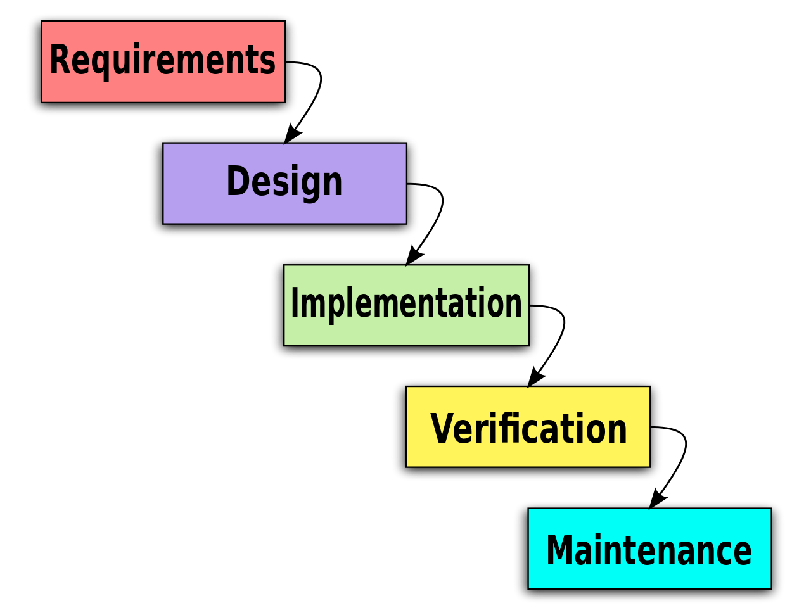
Intro to SW engineering ( Models)
SW Models
Sequential
Waterfall Model
V Model
Iterative
Waterfall Model
Cons :
Not flexible
There's no early test
Pros :
Suitable for small projects
Simple and easy to understand

Slide 7
Intro to SW engineering ( Models)
SW Models
Sequential
Waterfall Model
V Model
Iterative
V Model
Cons :
Complex for small and low risk projects
A lot of intermediate layers
Pros :
Early test
Risk management
Project is divided into atomic parts

Slide 8
Intro to SW engineering (Models → V-Model Process)
Requirements analysis
User acceptance test plan
User acceptance test
CRS, HSI
Functional Specifications
System Test
System test plan
SRS
High level design
System Integration Test
Integrated test plan
GDD
Low level design
Unit test plan
Unit Test
CDD
Software Implementation

Slide 9
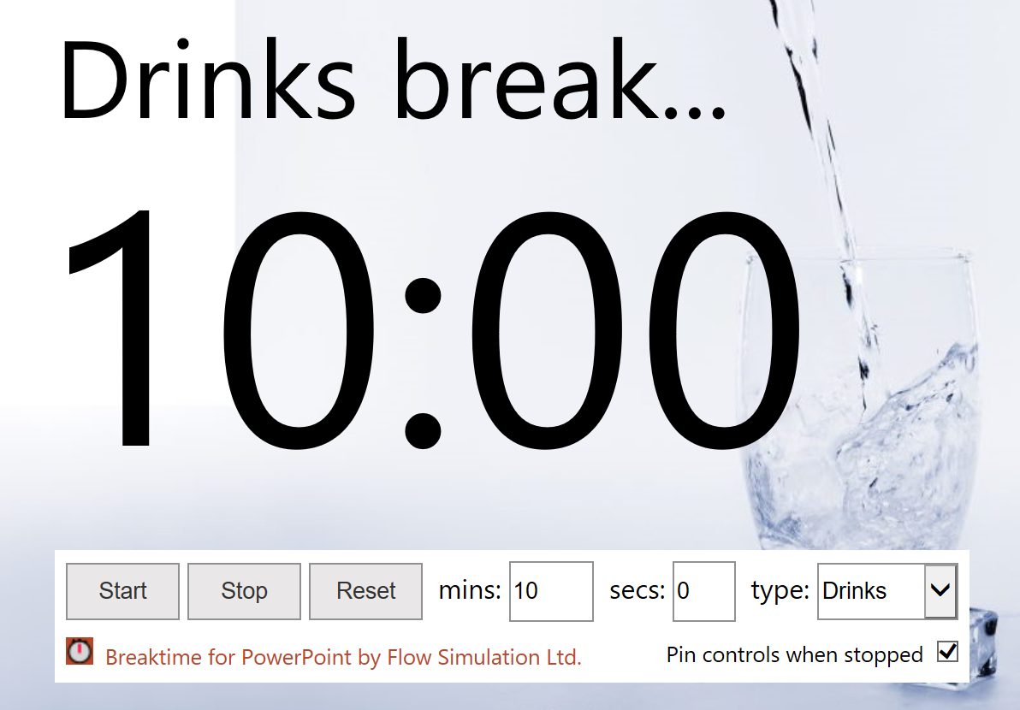
Break 10 min

Slide 10
02
Applying V-model

Slide 11
Requirement analysis
Applying V-Model ( CRS )
This is the first stage in the V-Model. Analyzing the requirements is the phase where the system engineers →
Break down the customer requirements (CR) into system requirement and generate the CRS document
Define which requirement to allocate to SW and which to HW. Then involve with HW team to initiate HIS document.
Define the overall system context.

Slide 12
Applying V-Model (Document structure )
Document naming convention
Table of content
Document status
Status :
Draft : document is under processing and not ready to review
Proposed : document is ready for review
Released : Reviewed and No more open review points
Structure : table has Status , Version , Date and Author
Document history
Structure : Table has version, Date, change author and change details.
Reference documents
Structure: table has Ref.Name, Doc.name, version and status

Slide 13
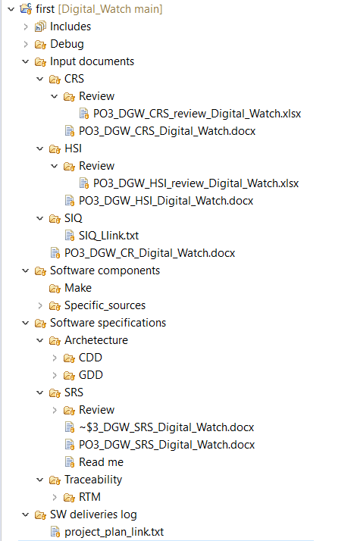
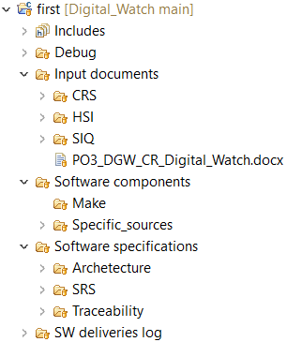
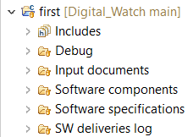
Applying V-Model (File structure )

Slide 14
Graduation project Idea
Prepare your Inputs
Applying V-Model (Before we start, prepare the CR)
Choosing idea
Analyze the idea
Match team members skills with what the idea requires
Define the current features and future work
Related work and market
Prepare your customer requirement based on the features your team agreed on.
Map each feature to a covers name following the naming convention we agreed on

Slide 15
CRS (customer requirements specification )
RTM (Requirement Traceability Matrix)
Review sheets
HSI (customer requirements specification )
Week Plan
Applying V-Model (CRS, HSI, RTM, Review sheets, and week plan)

Slide 16
RESOURCES
Omar, A. (n.d.). Software engineering. ITI 9-month Diploma, Embedded software track. 6th of October; ITI smart Village.
Martin, M. (n.d.). What is Software Engineering? Definition, Basics, Characteristics. https://www.guru99.com/what-is-software-engineering.html#2.
Structured methodology review. (2002). Software Engineering Handbook, 151–160. https://doi.org/10.1201/9781420031416-16.
Ruparelia, N. B. (2010). Software development lifecycle models. ACM SIGSOFT Software Engineering Notes, 35(3), 8–13. https://doi.org/10.1145/1764810.1764814

Slide 17

Break 10 min

Slide 18
03
Version control

Slide 19
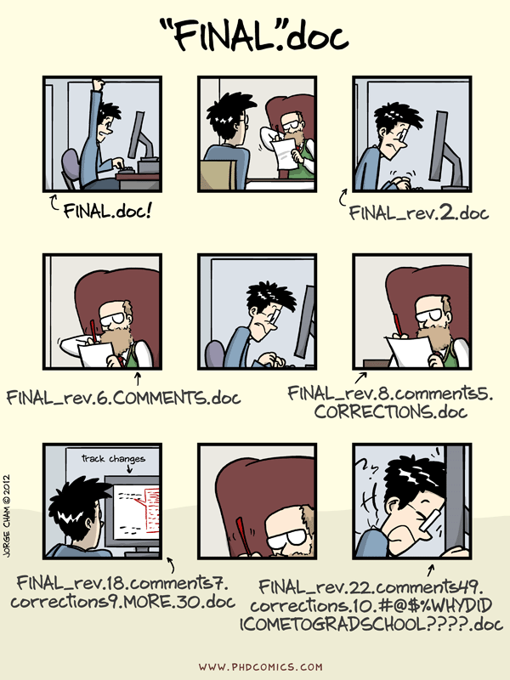
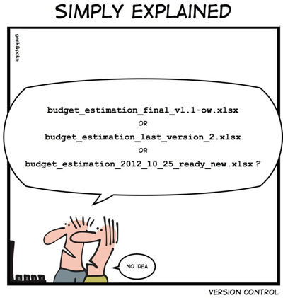
Version control
Do you have documents like that ?!
Got lost in your versions !
OR

Slide 20
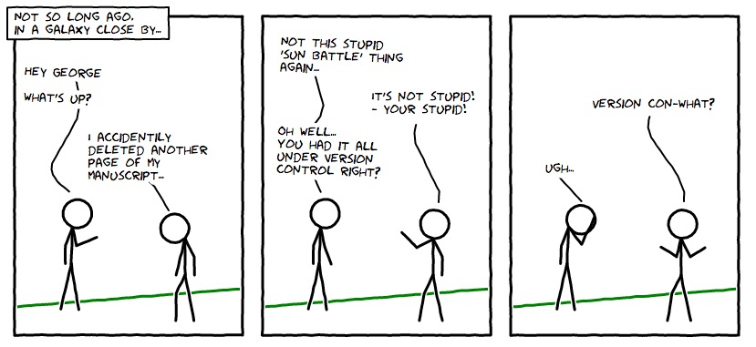
Version Control

Slide 21
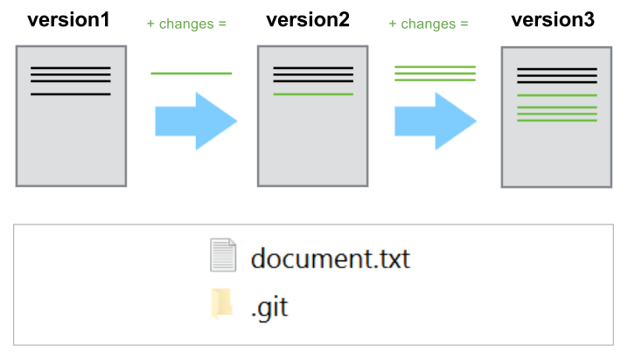
Version Control

Slide 22
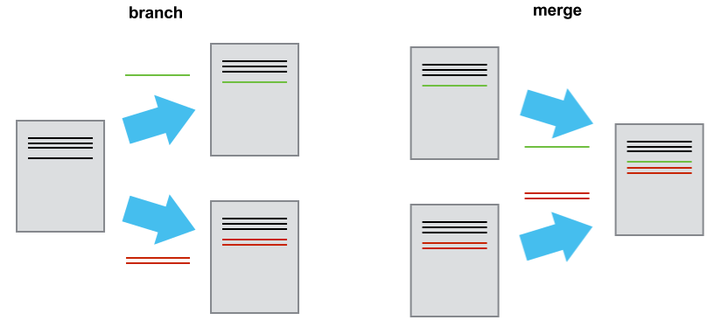
Version Control

Slide 23
RESOURCES
Git Extensions Documentation. (n.d.). https://buildmedia.readthedocs.org/media/pdf/git-extensions-documentation/latest/git-extensions-documentation.pdf.
What is version control? (n.d.). Bitbucket. https://www.atlassian.com/git/tutorials/what-is-version-control.
What is Version Control? (n.d.). https://uidaholib.github.io/get-git/1why.html.

Slide 24
04
Project Documentation

Slide 25
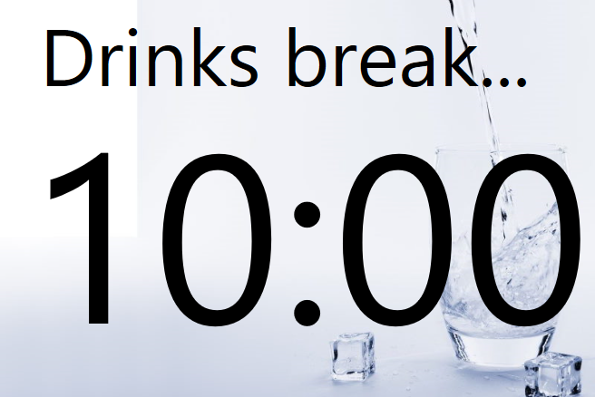
Break 10 min

Slide 26
05
Tools

Slide 27





Tools
MS Project
MS visio
MS Excel sheets
GIT extention
Google sheets
Planning
Manage resources
Building Diagrams
Review sheets
Manage repositories
SIQ

Slide 28
06
Tasks

Slide 29
Tasks
Task 1
Create GitHub repo with the same files structure we agreed on and add me as collaborator.
Task 2
Week plan using MS project
( with handling resources )
Task 3
Create CRS Document
Task 4
CRS Review Sheet

Slide 30
Tasks
Task 5
RTM, Review Sheet
Task 6
SIQ Sheet using Google sheets
Project Book Table of content
Task 7
Book Acknowledgement, Abstract, Purpose of Documentation, and Chapter 1
Task 8

Slide 31
Notes
Deadline
The deadline will always be Wednesday 11:59 PM so that I can do the review on Thursday before our session
And please don’t just repeat words , understand what you are adding before you write it down in the document.
Communication
You can always contact me through the team leader and vise versa. Or you can email me directly
Repo
Only team leader can Merge branches with the master brach and pushing on master have to be only after successful integration
Meeting / Session
We will meet every Friday at 9 PM.

Slide 32
THANKS
Please keep this slide for attribution

